Slide 1
State-Level Data on Immigrants Where to get it an how to use it David Dyssegaard Kallick Director of the Fiscal Policy Institute’s Immigration Research Initiative ddkallick@fiscalpolicy.org

Slide 2
Immigration 1850 to today
Fiscal Policy Institute analysis of Census and American Community Survey (ACS) data.
Notes:
An overview of where we are

Slide 3
Immigration 1850 to today
Fiscal Policy Institute analysis of Census and American Community Survey (ACS) data, and Pew Research Center estimates of unauthorized immigrant populations.
Notes:
Overview

Slide 4


Economic Role of Immigrants
A Super-Cool Tool from EPI and FPI
Based on 2011 data. We expect to have an update soon.
Notes:
1. Data tool you can use.

Slide 5
Economic Role of Immigrants
Notes:
Select a state.

Slide 6
Economic Role of Immigrants
Notes:
You get this…

Slide 7
Economic Role of Immigrants
Notes:
…And this.

Slide 8
Economic Role of Immigrants
U.S.-born and Foreign-born Populations
Gender, Race, and Ethnicity
Educational Attainment
Age Structure, Labor Force Participation, Unemployment
Wage and Salary Earnings (by Educational Attainment)
Poverty Rate
Family Income
White Collar, Blue Collar, and Service Occupations
Top 15 Detailed Occupations
Industries Where Immigrants Work
Business Owners
Immigrant Share of State GDP
Top 15 Places of Birth for Immigrants
Unauthorized (undocumented) Immigrants (Pew)
Trend in Unauthorized Population (Warren & Warren)
Notes:
If you can’t read the fine print: here are the tables.

Slide 9
Economic Role of Immigrants
U.S.-born and Foreign-born Populations
Gender, Race, and Ethnicity
Educational Attainment
Age Structure, Labor Force Participation, Unemployment
Wage and Salary Earnings (by Educational Attainment)
Poverty Rate
Family Income
White Collar, Blue Collar, and Service Occupations
Top 15 Detailed Occupations
Industries Where Immigrants Work
Business Owners
Immigrant Share of State GDP
Top 15 Places of Birth for Immigrants
Unauthorized (undocumented) Immigrants (Pew)
Trend in Unauthorized Population (Warren & Warren)
Notes:
…And this.

Slide 10
Economic Role of Immigrants
A memo
A report to use as a model
Feel free to call for help
Notes:
We have done several things to walk through how these data can be useful.

Slide 11
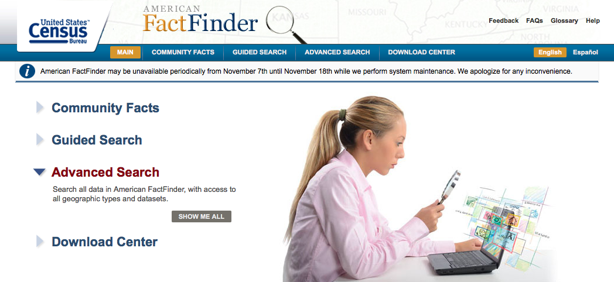
Economic Role of Immigrants
American Factfinder
“Advanced Search”
Notes:
Another place to turn: American Factfinder

Slide 12
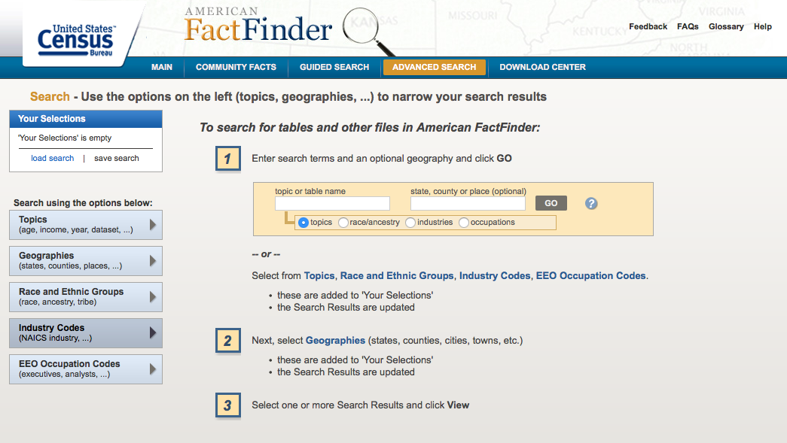
Economic Role of Immigrants
American Factfinder

Slide 13
Economic Role of Immigrants
American Factfinder
Select Geography
Search for “foreign” or “foreign-born” or “citizen”
(Also: “Place of Birth”)
“Selected Characteristics of the Native and Foreign-born” is always good
Decide: 1-year, 3-year, or 5-year data?
You can go back to 2000 easily to get trends.

Slide 14
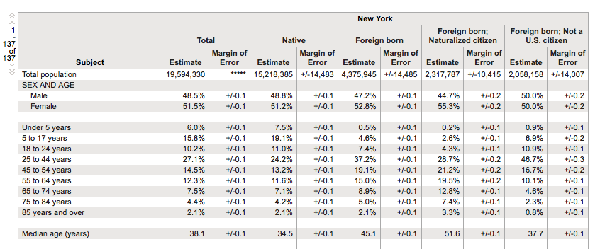
Economic Role of Immigrants
American Factfinder
Note: Native (we usually use the term U.S.-Born, or citizen by birth). Foreign-born is then divided into Naturalized citizen and non-citizen.

Slide 15
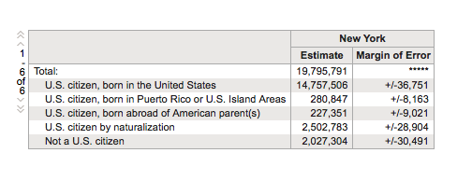
Economic Role of Immigrants
American Factfinder
“Nativity and Citizenship Status in the United States”
(Different titles in different data years)

Slide 16
Economic Role of Immigrants
American Factfinder
Advantages:
Great for small geography
Always latest data
Quite a lot there – and seems to be more all the time
Pretty easy to use

Slide 17
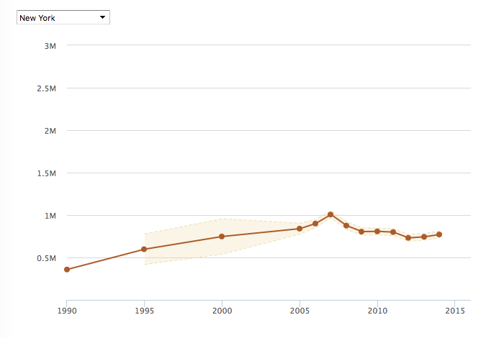
Estimates of Undocumented Immigrants
1. Pew Research Center
Note scale.
http://www.pewhispanic.org/interactives/unauthorized-trends/

Slide 18
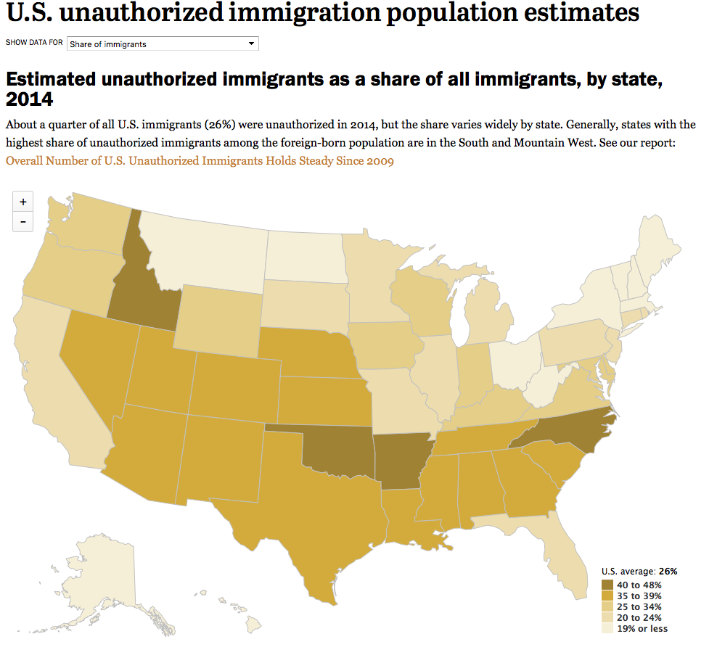
http://www.pewhispanic.org/interactives/unauthorized-immigrants/

Slide 19
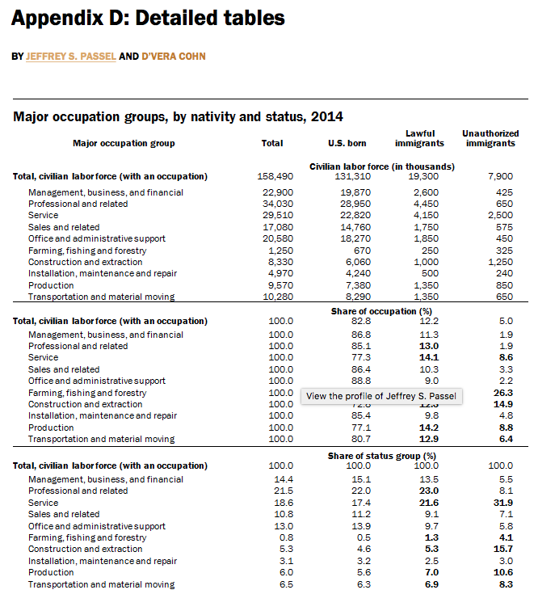
http://www.pewhispanic.org/2016/11/03/appendix-d-detailed-tables/

Slide 20
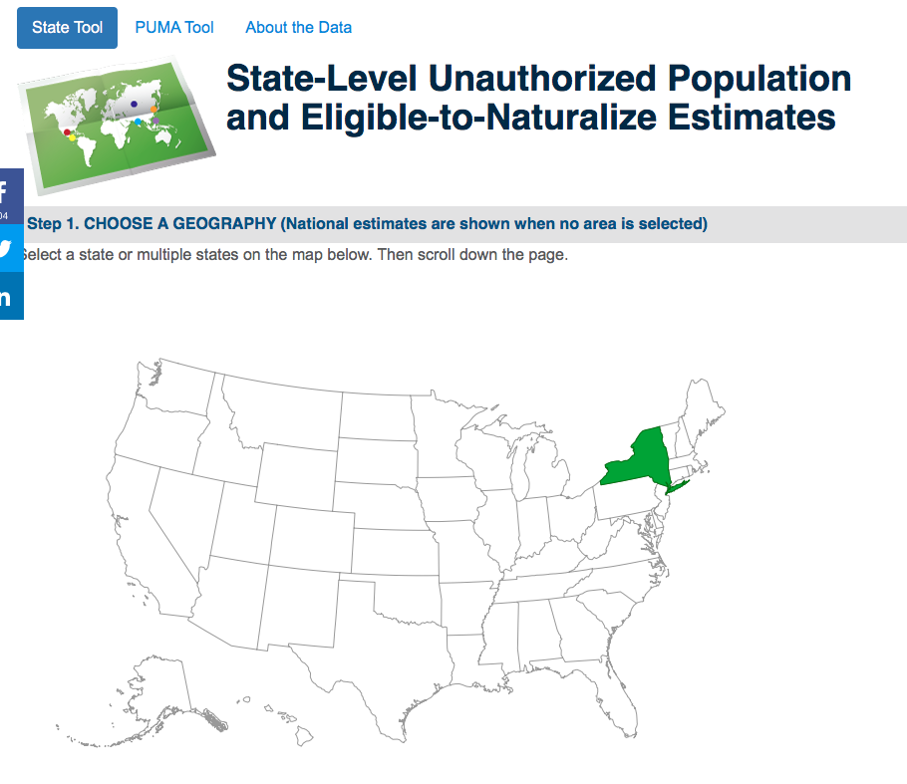
Estimates of Undocumented Immigrants
2. Center for Migration Studies
http://data.cmsny.org

Slide 21
CMS data includes
Continent/Region of Origin
Top 25 Countries of Origin (U.S., 2014)
Period of Entry
Years in the United States
Entered Prior to 2010
Language Spoken at Home
Ability to Speak English (5 years and older)
School Enrollment (3 years and older)
Educational attainment (18 years and older)
Marital status (15 years and older)
Age (in years)
Sex
Access to a computer or the internet (2014 only)
Poverty Status
Employment status (16 years and older)
Occupation
Health Insurance Coverage
Race by Ethnicity

Slide 22
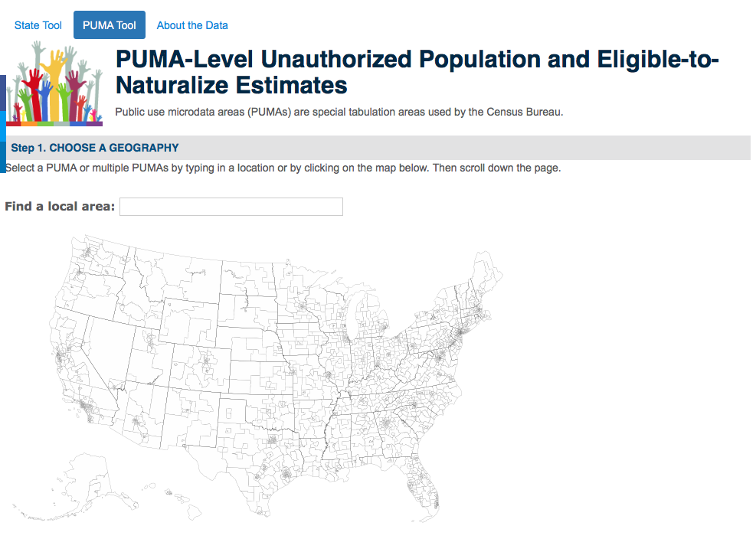
http://data.cmsny.org/puma.html

Slide 23
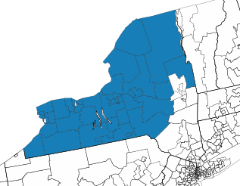
PUMA-Level Data
Customizable Regions. But: Be careful of sample size.

Slide 24
CMS data may be the best for state-level trends
You can use the EPI/FPI tool up to 2010, and then add 2012 and 2014

Slide 25
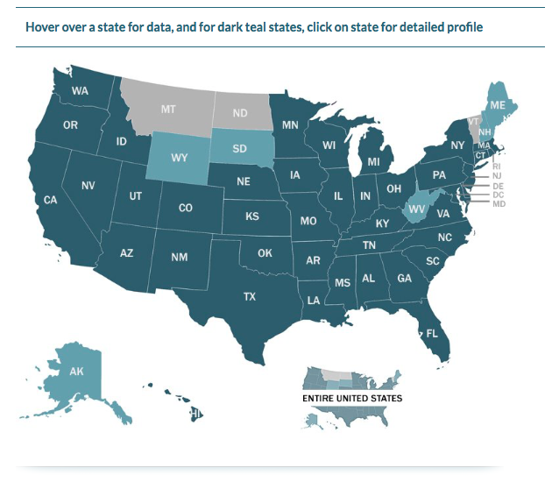
Estimates of Undocumented Immigrants
3. Migration Policy Institute
http://www.migrationpolicy.org/programs/us-immigration-policy-program-data-hub/unauthorized-immigrant-population-profiles

Slide 26
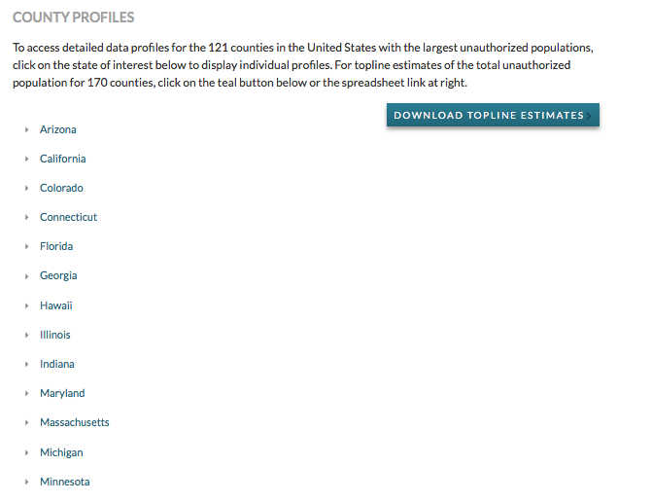

Slide 27
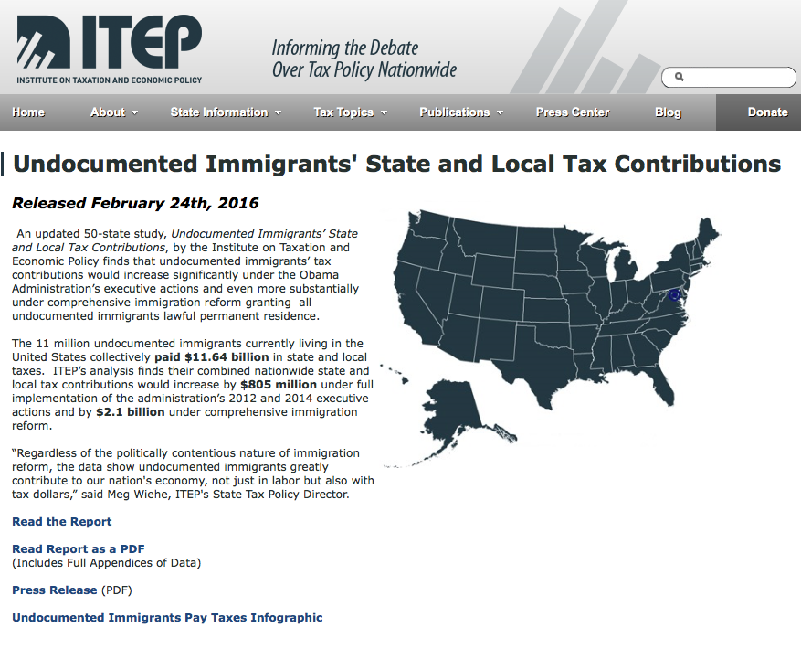
State & Local Taxes Paid by Undocumented Immigrants
http://www.itep.org/immigration/

Slide 28
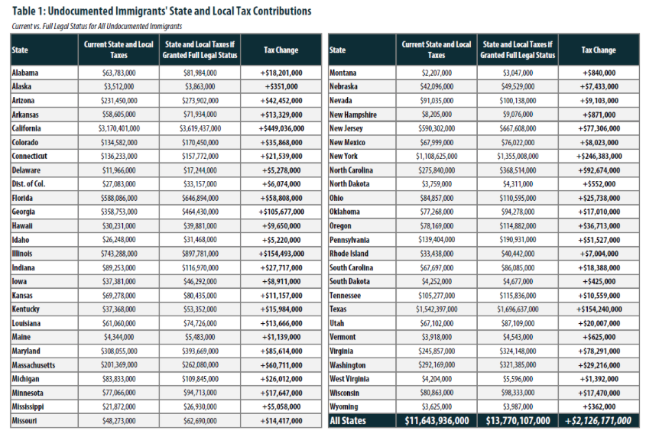

Slide 29
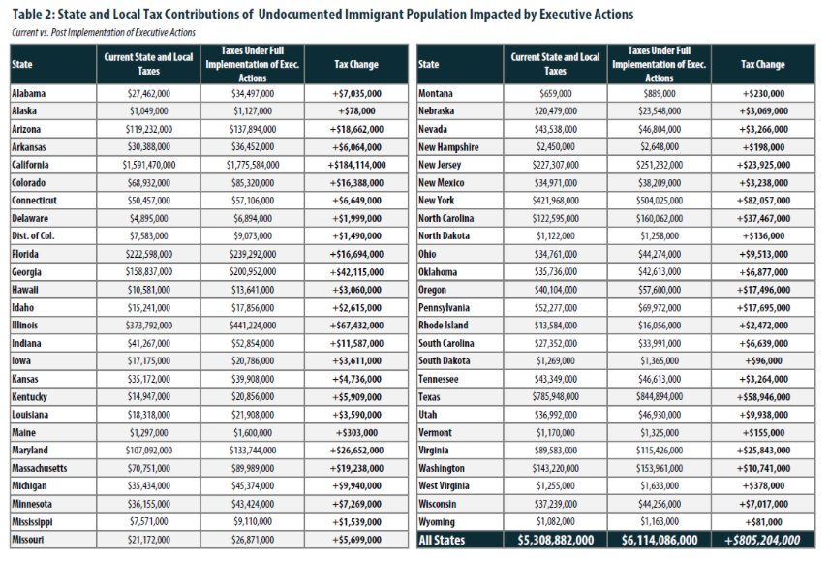

Slide 30
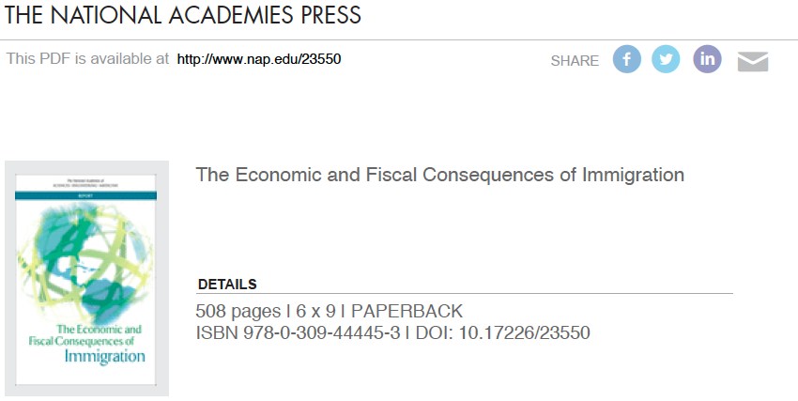
https://www.nap.edu/catalog/23550/the-economic-and-fiscal-consequences-of-immigration

